Slide 1
PFAS Study Status
January 30, 2019
Martha’s Vineyard Airport
Presented by Ron Myrick, P.E., L.S.P.

Slide 2
Presentation Overview
PFAS and AFFF Background
Initial MVY Study Summary
Private Well Sampling Results Summary
Immediate Response Action Plan to MassDEP
Initial Treatment System Install and Test
Public Outreach and Communication

Slide 3
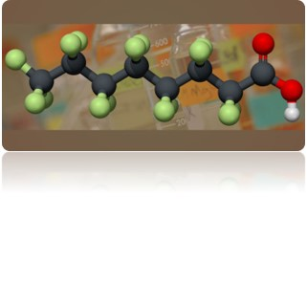
PFAS Background
Manufactured since the 1940s
Very stable compounds
Water soluble and mobile in groundwater
Bioaccumulate
Some PFAS compounds determined to be toxic with high concentrations and/or long-term exposure:
Developmental effects in fetuses
Likely impacts to thyroid, liver, kidneys, hormone levels and the immune system
Possible cancer risk

Slide 4
Where are PFASs found?
Teflon (e.g. non-stick cookware)
Waterproof textiles (e.g. Tyvek, GoreTex)
Scotchgard, Stainmaster and other stain/water proofing products
Waxes (e.g. ski, automotive, floor)
Food wrappers (e.g., fast food containers and wraps, pizza boxes)
Microwave popcorn bags
Dental floss
Shampoos/sunscreens/moisturizers/insect repellents
Cosmetics
AFFF – Fighting petroleum fires (Class B Foam)
PFASs are present in numerous everyday products and supplies
Notes:
Point of this slide should just be to illustrate that PFASs are everywhere and that is why we have to follow these special sampling procedures. Worth noting here that we have DLs on the ng/L level.

Slide 5
Recent Regulatory Changes
PFAS are “emerging contaminants”
No current enforceable standards exist in Massachusetts for PFAS compounds in drinking water…however
May 2016: USEPA issued a Health Advisory of 0.070 ug/L for 2 PFAS compounds – PFOS and PFOA (70 parts per trillion or ppt)
June 2018: MassDEP issued a long-term exposure drinking water guideline of 0.070 ppt as the sum of 5 target PFAS compounds and Interim Guidance
In Massachusetts, enforceable standards for PFAS in soil and groundwater are expected soon (draft standards winter 2019)

Slide 6
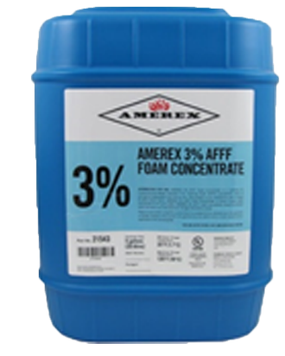
AFFF Development and Usage
AFFF developed in the 1960s for the US Navy
Synthetic foam
Spreads across the surface of hydrocarbon fuels
Forms a water film which cools the liquid fuel and extinguishes the fire
FAA mandated usage and testing at airports
Foam tests typically required bi-annually per FAA Order 5280.5C (Airport Certification Program Handbook)
NFPA 412 (Standard for Evaluating Rescue and Fire-Fighting Foam Equipment)
Part 139 CertAlert – 1/17/2019: new AFFF testing methods without foam discharge were approved

Slide 7
AFFF
Aqueous Film Forming Foam – Class B
Past testing and fire fighting usage has resulted in AFFF solutions entering the environment:
Directly to the ground surface
Into storm drain systems to discharge locations

Slide 8
MVY Study Summary
Tetra Tech retained to initiate a voluntary assessment of potential PFAS impacts at MVY from AFFF in January 2018
Interviews and research regarding past AFFF usage
Drilling to assess soil and install groundwater monitoring wells at historic AFFF testing or usage areas
Groundwater sampling of new and existing monitoring wells
Development of AFFF Management Plan
MassDEP issued PFAS long-term drinking water guidance in June 2018 (70 ppt as the sum of 5 target PFAS)
Further assessment of MVY and in downgradient target study area in October 2018
Targeted additional monitoring well sampling
Residential well sampling

Slide 9
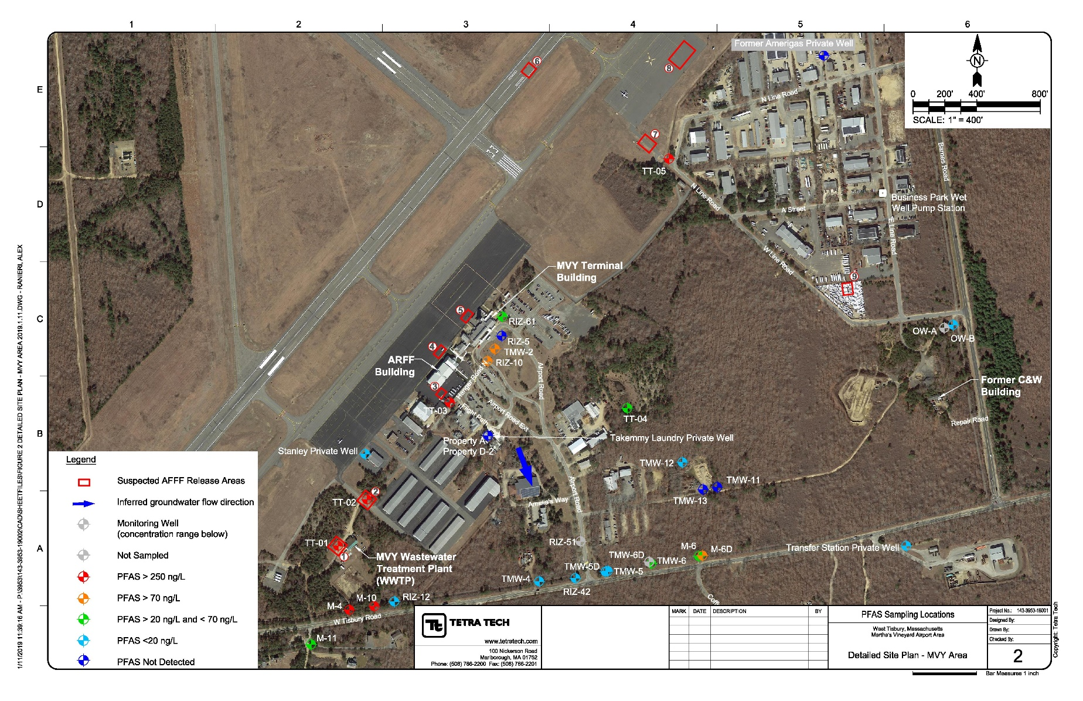
Initial MVY Study Summary

Slide 10
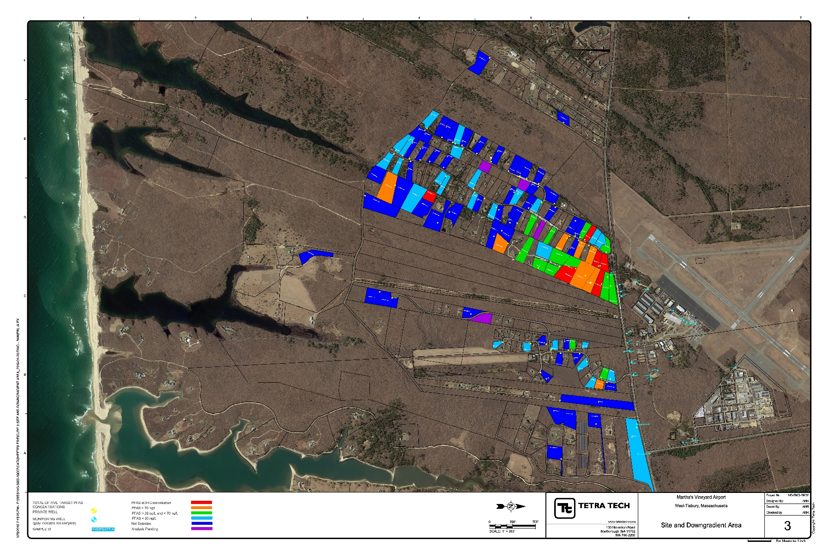
Private Well Sampling Results Summary

Slide 11
Private Well Sampling Overview
(110) private wells sampled and reported to date
Detected target 5 PFAS up to 1,358 ppt
(14) results exceed MassDEP guideline of 70 ppt
(13) results between 20 ppt and 70 ppt
Higher PFAS concentrations closer to E-WT Road
(2) additional private wells sampled 1/30/2019
Continued additional sampling of monitoring wells and private wells in response to investigation results

Slide 12
Immediate Response Action Plan
Immediate Response Action Plan submitted to MassDEP on 1/18/2019
Summary of investigation to date
Plan for near-term response actions
Bottled water
Point-of-entry (whole house) treatment systems
Additional source assessment plan
Potential contributing PFAS sources
Investigation to support long-term solutions
Monitoring plan within study area
MassDEP has 21 days to provide comments

Slide 13
Point-of-Entry Treatment Systems
Point-of-Entry (whole house) treatment systems are planned for private wells where the sum of the 5 target PFAS is greater than 20 ppt.
Conservative target concentration due to current unknowns regarding PFAS
Considers background presence of PFAS in the environment that are unrelated to AFFF
No current MassDEP finalized risk-based standards
Reconsideration of the target concentration for treatment is warranted once MassDEP issues risk-based standards
Review of detectable PFAS (less than 20 ppt) in collaboration with MassDEP

Slide 14
Point-of-Entry Treatment Systems
Point-of-Entry treatment systems
(2) 12” x 42” upflow type polyethylene vessel with 55 pounds of granular activated carbon (GAC) connected in series
Cartridge sediment filter
Flow totalizer
Proven effectiveness and readily-available technology
Installations planned winter/spring

Slide 15
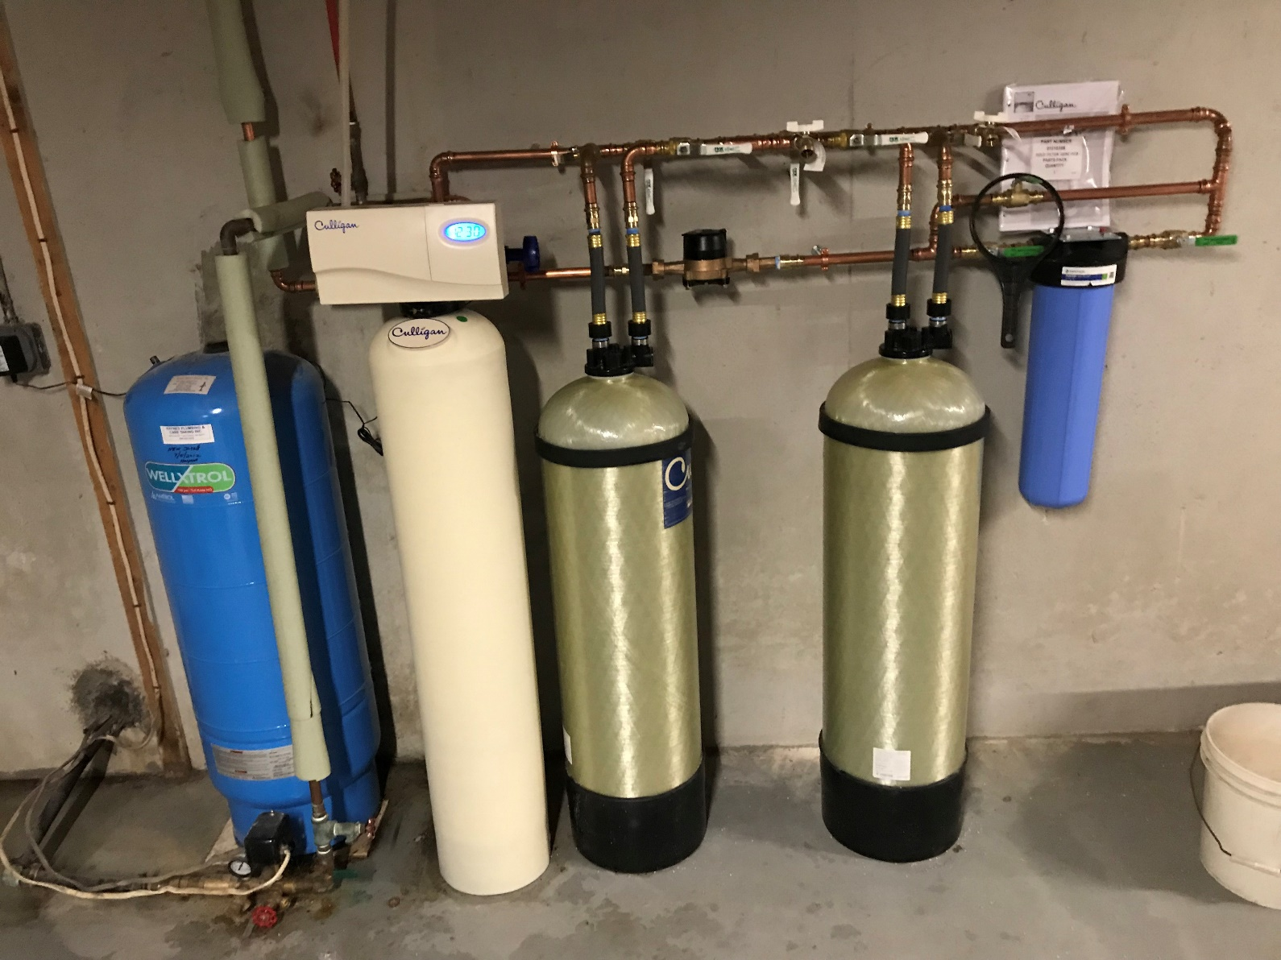
Initial POE Treatment System Install and Test

Slide 16
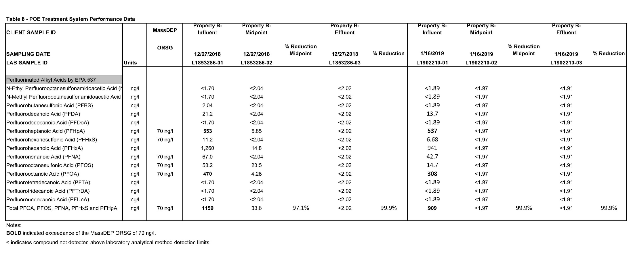
Initial POE Treatment System Install and Test

Slide 17
Additional Investigation and Monitoring
Install treatment systems
Monitor performance through sampling initially and periodically
Continue to sample residential wells in study area
Address data gaps in study area
Resample select private wells
Evaluate PFAS sources and groundwater migration
Assess potential current and historic PFAS sources
Install and sample new monitoring wells
Evaluate long-term solutions
Mitigate PFAS sources and migration

Slide 18
Public Outreach and Reports
Immediate Response Action Plan availability
Martha’s Vineyard Airport website (www.mvyairport.com)
Download from MassDEP website under RTN 4-27571
(https://eeaonline.eea.state.ma.us/portal#!/search/wastesite)
Parties on distribution list will be provided notice regarding report availability
Updates during MVAC meetings
Monthly IRA Status Reports to MassDEP

Slide 19
Licensed Site Professional/Project Manager Ronald E. Myrick, Jr., P.E., L.S.P. ron.myrick@tetratech.com 508-786-2363 MassDEP Contact Angela Gallagher Angela.Gallagher@state.ma.us 508-946-2790 Toxicity and Risk Assessment Support Not paid by Tetra Tech or MVAC but funded by a Federal Grant Wendy Heiger-Bernays, PhD Boston University Superfund Research Program whb@bu.edu 617-358-2431

